Slide 1

Introduction to AI(AI101B) Even Semester Session 2024-25
SENTIMENT ANALYSIS OF TWITTER DATA
Team Leader: Ridhi Rajput (2426MCA334)
Member: Sanket Pundhir(2426MCA503)
Member: Namrta Singh(2426MCA680)
Project Supervisor:
Mr. Apoorva Jain
Assistant Professor

Slide 2

Content
Introduction
Sustainable Development Goal
Introduction
Natural Language Processing
Preprocessing Tweet Content
Machine Learning Algorithms
Deep Learning
Python Libraries
Data Visualization
Workflow
Results
References
Notes:
Font Styles: Times New Roman + Font Size: 25

Slide 3

Sustainable Development Goal
Our project will likely contribute to following SDGs:
🔹 SDG 9 – Industry, Innovation, and Infrastructure: Promotes the use of AI and Machine Learning technologies. Encourages innovation in natural language processing for social media analysis.
🔹 SDG 16 – Peace, Justice, and Strong Institutions: Helps monitor public sentiment on social issues. Aids policymakers, NGOs, and governments in understanding public opinion for better decision-making.
🔹 SDG 17 – Partnerships for the Goals: Encourages collaboration between technology developers, researchers, and policy influencers. Demonstrates how open-source tools and frameworks can contribute to solving global challenges.

Slide 4

Introduction
In today’s digital age, Twitter has become a powerful platform where users express their opinions on various topics in real-time. This project, Twitter Sentiment Analysis using NLP, aims to analyze these tweets to determine whether the sentiment behind them is positive, negative, or neutral. We use Natural Language Processing (NLP) techniques and Machine Learning algorithms to process the text and classify sentiments. A user-friendly web interface built with Flask allows users to input tweets and instantly see the sentiment analysis results, along with a confidence score.
Notes:
Font Styles: Times New Roman + Font Size: 25

Slide 5

Natural Language Processing (NLP)
Definition
Purpose
Computers understand and process human language
Preprocess and interpret tweet content effectively
Libraries
Text Cleaning
NLTK for tokenization, stemming, lemmatization
Removing URLs, hashtags, emojis

Slide 6

Preprocessing Tweet Content
Text Cleaning
Crucial for accurate sentiment analysis
Remove URLs
Eliminates irrelevant website links
Remove Hashtags
Cleans noise from topic markers
Remove Emojis
Simplifies text for analysis

Slide 7
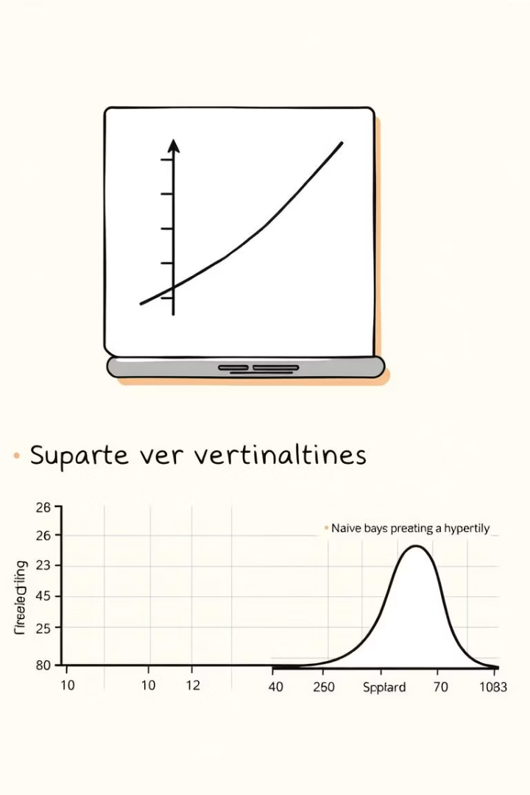




Machine Learning Algorithms
Logistic Regression
SVM
Naive Bayes
Effective in high-dimensional spaces
Fast, good for large datasets
Simple, efficient binary classification
Scikit-learn
Popular ML implementation library

Slide 8
Python Libraries
Flask
Web framework to create the user interface and handle requests/responses.
NLTK
Natural language processing
Scikit-learn
Machine learning tools
re
Regex for removing mentions, URLs, etc.

Slide 9
Workflow
1
Data Collection
Gather tweets with Twitter API
2
Preprocessing
Clean and transform tweets
3
Feature Extraction
Convert text to numeric features
4
Model Training
Train sentiment models
5
Evaluation
Assess model performance

Slide 10
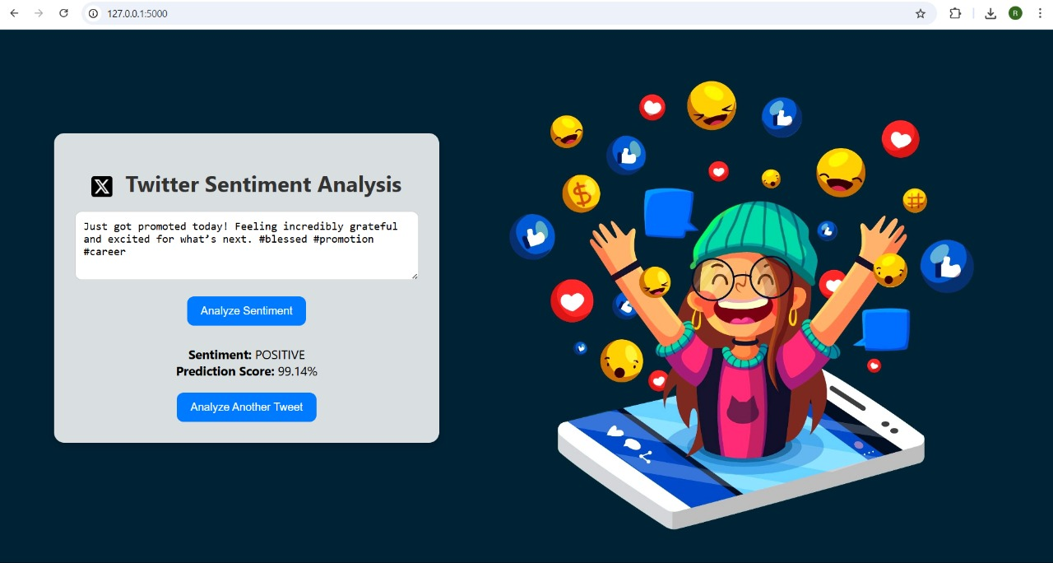
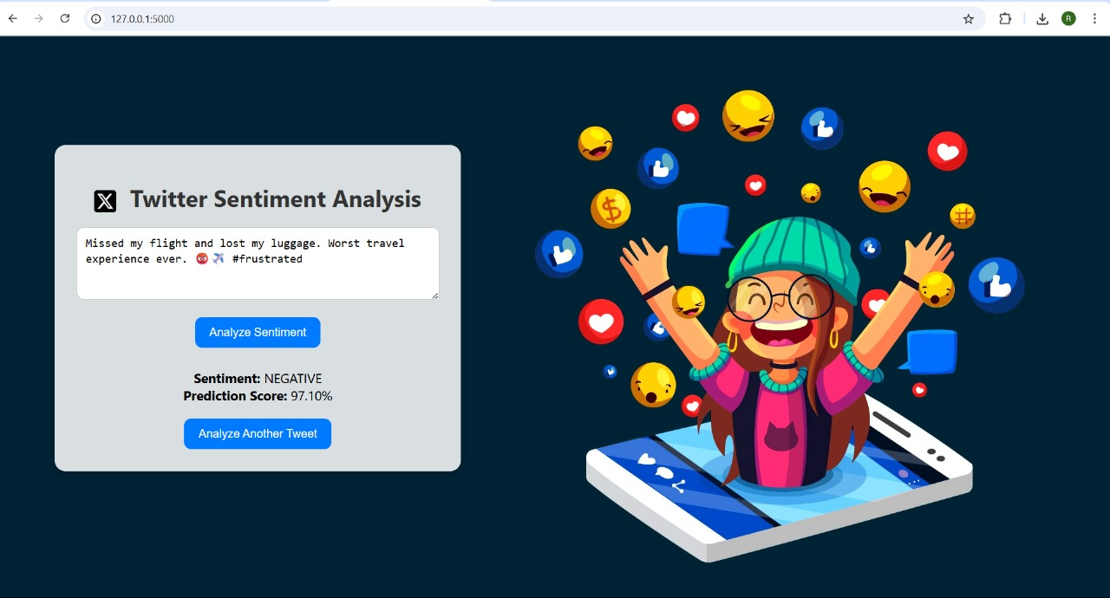
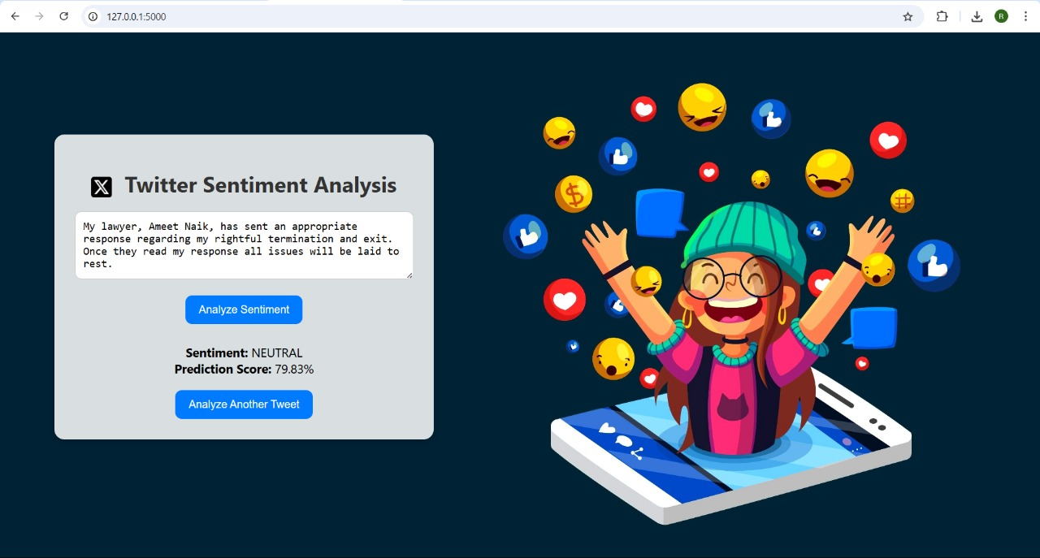
Results
Positive Sentiment
Negative Sentiment
Neutral Sentiment
Notes:
Font Styles: Times New Roman + Font Size: 25

Slide 11
References
1. Devlin, J., et al. (2018). BERT: Pre-training of Deep Bidirectional Transformers for Language Understanding.
2. J. Devlin, M. Chang, K. Lee, and K. Toutanova, “BERT: Pre-training of Deep Bidirectional Transformers for Language Understanding,” in NAACL, 2019.
3. A. Go, R. Bhayani, and L. Huang, “Twitter Sentiment Classification using Distant Supervision,” CS224N Project Report, Stanford, 2009.
4. Y. Liu et al., “RoBERTa: A Robustly Optimized BERT Pretraining Approach,” arXiv preprint arXiv:1907.11692, 2019.
5. P. Potash, A. Romanov, and A. Rumshisky, “SemEval-2017 Task 4: Sentiment Analysis in Twitter,” in SemEval, 2017.
6. M. Hu and B. Liu, “Mining and Summarizing Customer Reviews,” in KDD, 2004.

Slide 12

THANK YOU!

